Slide 1

Green Pace
Security Policy Presentation
Developer: Marco Martinez

Slide 2

OVERVIEW: DEFENSE IN DEPTH

Slide 3
THREATS MATRIX
Likely STD-002-CPP STD-003-CPP STD-004-CLG STD-007-CPP STD-008-CPP STD-009-CLG | Priority STD-002-CPP STD-003-CPP STD-004-CLG STD-007-CPP STD-008-CPP STD-009-CLG
Low priority STD-001-CPP STD-005-CPP STD-006-CLG STD-010-CLG | Unlikely STD-001-CPP STD-005-CPP STD-006-CLG STD-010-CLG

Slide 4
10 PRINCIPLES
Validate Input Data
Heed Compiler Warnings
Architect and Design for Security Policies
Keep it Simple
Default Deny
Adhere to the Principle of Least Privilege
Sanitize Data Sent to Other Systems
Practice Defense in Depth
Use Effective Quality Assurance Techniques
Adopt a Secure Coding Standard

Slide 5
CODING STANDARDS
Make sure you declare identifiers before use
Make sure that signed integers do not overflow
Do not attempt to modify a string literal
Prevent SQL Injection
Do not leak resources when handling exceptions
Use static assertions to test constant expression’s values
Honor exception specifications
Don’t delete a polymorphic object without a virtual destructor
Do not read from uninitialized memory
Do not declare or define a reserved identifier

Slide 6
ENCRYPTION POLICIES
Encryption in rest
Preventing physically stored data from being compromised
Encryption at flight
Preventing data amidst transfer from being compromised
Encryption in use
Preventing data from being compromised whilst in use actively in memory

Slide 7
TRIPLE-A POLICIES
Authentication
Focuses on ensuring a user is who they say they are through valid credentials. This is important because you want to be able to identify what an individual should have access to
Authorization
Focuses on whether an individual has access to what they should have access to. This is important because you wouldn’t want a regular user to have administrative abilities for a website as they could manipulate the backend data
Accounting
Focuses on accounting for what a user might be doing. In case of failure in the previous categories, a log consisting of what users do would inform an administrator of a user utilizing privileges they ought not have.

Slide 8


STD-001-CPP
The variable is not assigned a specifier
Variable is assigned specifier “int”

Slide 9

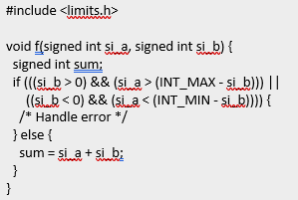
STD-002-CPP
Doesn’t check accumulation amount
Checks that int doesn’t overflow

Slide 10


STD-003-CLG
String literals shouldn’t be modified through an index when by reference
Define literal as array for effective individual element identification

Slide 11
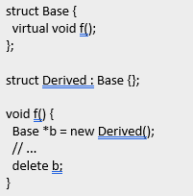
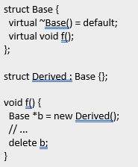
STD-008-CPP
No access to virtual destructor
Virtual destructor defined and accessible

Slide 12

AUTOMATION SUMMARY

Slide 13
TOOLS
DevOps pipeline promotes a constant cycle of development and operation with potential for constant operations to the code. DevSecOps introduces security into the mix.
DevSecOps allows for external tools all throughout both development, deployment and maintenance.

Slide 14
RISKS AND BENEFITS
The upfront cost associated with implementing these security features are time and money.
This time and money is an investment to prevent having to double back later to invest the same time and money into a fix AND implementing damage control in case of system breach which would cost further time and money.

Slide 15
RECOMMENDATIONS
Understand ten core security principles
Implement coding standards
Utilize Triple-A Framework
Understand and integrate encryption in rest/flight/use

Slide 16
CONCLUSIONS
Avoiding potential calamities
Minimize risk during potential breach

Slide 17
REFERENCES
Data Protection: Data In transit vs. Data At Rest. (2019, July 15). Digital Guardian. https://digitalguardian.com/blog/data-protection-data-in-transit-vs-data-at-rest#:%7E:text=Data%20in%20transit%2C%20or%20data,or%20through%20a%20private%20network.&text=Data%20protection%20at%20rest%20aims,on%20any%20device%20or%20network.
Lim, F., & Lim, F. (2016, September 9). Explained — Blog. DevSecOps. https://www.devsecops.org/blog/tag/DevSecOps+Explained
Mylonas, L. (2018, November 27). What is AAA security? An introduction to authentication, authorisation and accounting. Codebots. https://codebots.com/application-security/aaa-security-an-introduction-to-authentication-authorisation-accounting#:%7E:text=Authentication%2C%20authorisation%20and%20accounting%20(AAA,strict%20access%20and%20auditing%20policies.

